Slide 1

DHCP AND PXE SERVER
Hadeer Ali Ahmed Ibraheem
Alaa Hassan Ali Mohamed
Monica Saaid Mikhail Botros
SUPERVISED BY:
ENG: MOHAMED EL GAMMASY

Slide 2
DHCP
Dynamic Host Configuration Protocol (DHCP) is a network management protocol used to automate the process of configuring devices on IP networks. A DHCP server dynamically assigns an IP address, Subnet mask, gateway, domain name, hostname and other network configuration parameters to each device on a network so they can communicate with other IP networks.

Slide 3
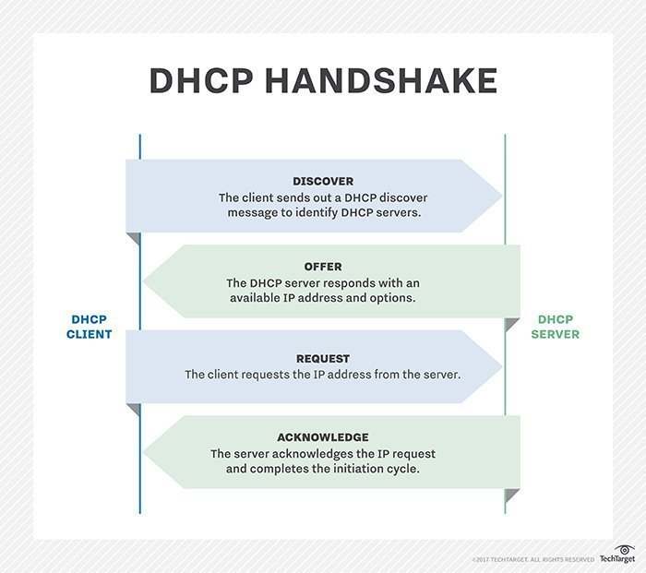
DHCP Operation (dora)

Slide 4

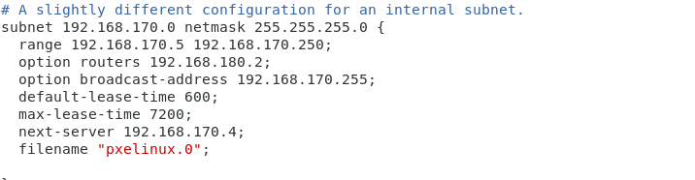
Our steps
We stopped the DHCP on VMware and added a new host only network adapter to our machine.
Install and enable DHCP package.
3. DHCP server configuration :
DHCP Server must has a network card with IP from this subnet, so we configured a static IP address to the machines new network card and brought the connection up.
Copy example file to /etc/dhcp
# cp /usr/share/doc/dhcp-4.2.5/dhcpd.conf.example /etc/dhcp/dhcpd.conf
Edit /etc/dhcp/dhcpd.conf
Restart dhcpd service
#systemctl restart dhcpd

Slide 5
DHCP
Test:
Create a VM, with Network card Host-only.
Reboot the client
During the reboot of the client keep your eye on /var/log/messages on the server to watch DORA
Check ip on the client

Slide 6
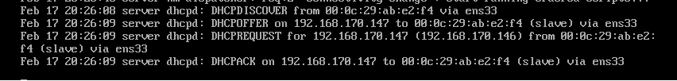
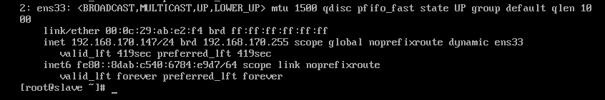
Screenshots
DORA on the server
The client got an IP

Slide 7
Pxe server
It stands for Pre-boot Execution Environment.
PXE is a key part of data center infrastructure, because it enables automated provisioning of servers or workstations over a network.
PXE can greatly simplify large deployments of computers. It replaces using a compact disc (CD) or Universal Serial Bus (USB) drive to install an OS. A single OS image can be quickly installed on many computers simultaneously.
The primary use of PXE is to install a fresh OS on new or malfunctioning computers. This can be a client OS, such as Windows 10 or Ubuntu Linux, or a server OS, like Windows Server 2019 or Arch Linux.

Slide 8
Needed components
A typical PXE environment has the following components.
PXE enabled NICs
DHCP Server
In a PXE boot environment there is always a DHCP server. The machines that are being provisioned are DHCP clients. The PXE enabled NIC has a DHCP client built into its firmware.
It usually consists of an IP address for use by the client, a default gateway address and DNS servers to use for name resolution. In the case of PXE, an option that contains the IP address of the server to download its boot files from (next-server).
TFTP Server
TFTP stands for trivial file transfer protocol. It is a simple UDP based protocol for getting or sending a file. There is no directory listing, you must know the exact path of the file you want to download. Additionally, there is no authentication or authorization.

Slide 9
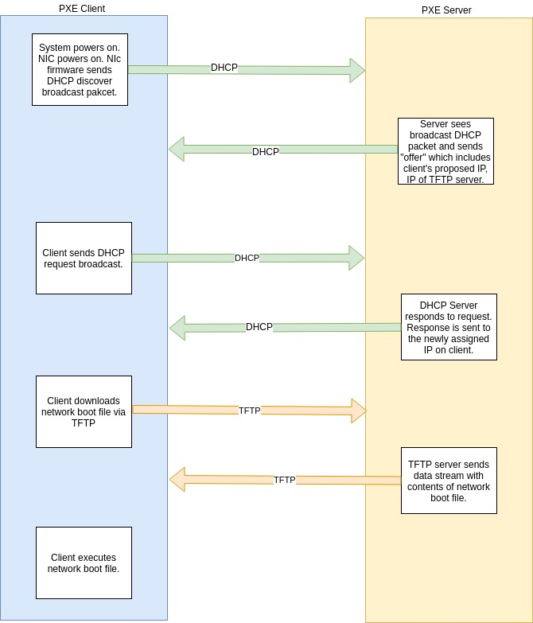

Slide 10
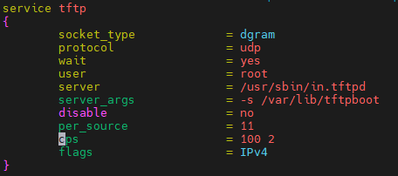
STEPS
1. Installing needed packages.
• DHCP-Server - A DHCP server provides a network configuration to clients. Specifically.
• TFTP Server – a simple lockstep File Transfer Protocol which creates bootable images available to be downloaded via a network.
• Syslinux – a Linux boot loader that provides boot loaders for network booting.
2. Configure dhcp server.
We defined the subnet, the domain name and dhcp range in the following file.
/var/dhcp/dhcpd.conf
3. Enabling tftp server.
We did that by configuring the following file and
changing disable to no instead of yes.
/var/xinetd.d/tftp

Slide 11
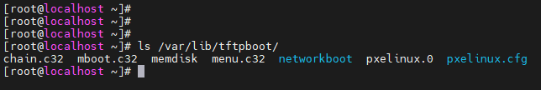
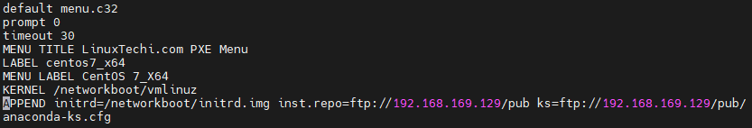
STEPS
And then we copied all boot files, Kernel file and initrd file to tftp directory.
/var/lib/tftpboot
4. Copying Iso file.
We copied the contents of iso file to the local tftp server.
5. Creating PXE menu and editing kickstart files.
/var/lib/tftpboot/pxelinux.cfg/default

Slide 12
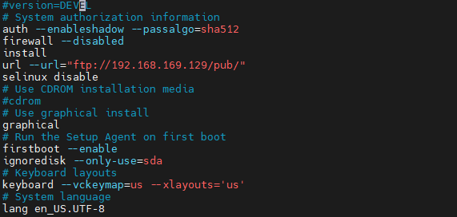
STEPS
/var/ftp/pub/anaconda-ks.cfg
6. Starting and allowing the services.
Boot the clients with pxe boot option.
Clients must have host only NiC while server must have Nat NiC and host only.

Slide 13
Challenges we faced
Errors | Solution
Client couldn’t read kickstart file. | Changing permissions of this file on the server.
Copying iso files in GUI Centos7 didn’t work (the minimal version worked well). | Mounting the iso files instead of copying it.
Couldn’t mount /dev/root error. | Checking kickstart configuration file.
Couldn’t complete installation on client. | Another error in kickstart file is fixed by removing cdrom.

Slide 14
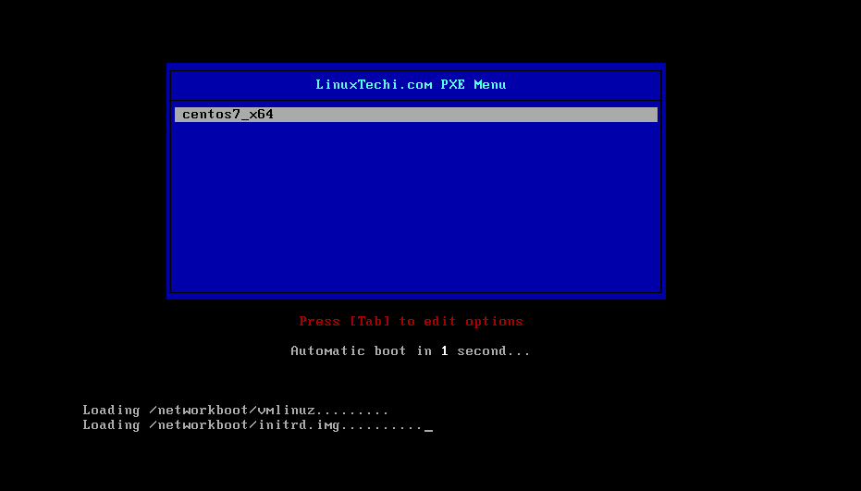
screenshots

Slide 15
PXE & iPXE
The PXE standard has been around for a long time, TFTP even longer. The protocol was really designed to get small payloads down over shaky networks that operated at 10Mb/s at best.
iPXE is the leading Open Source network boot firmware, which offers a small footprint boot loader, which allows the system to switch to a better suited protocol for high speed.
iPXE also offers you the ability to:
boot from a web server via HTTP.
boot from a wireless network.

Slide 16

Thank You

